Slide 2
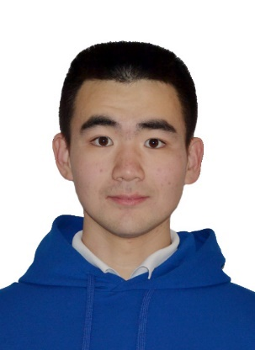
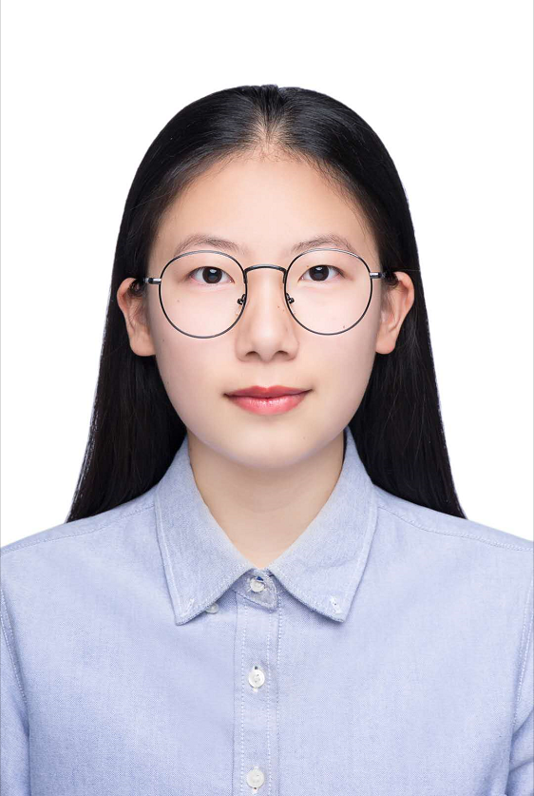
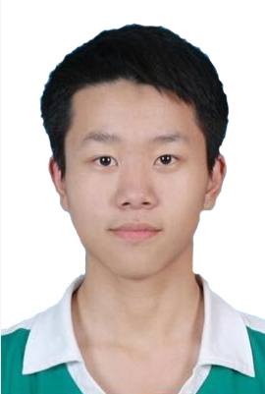
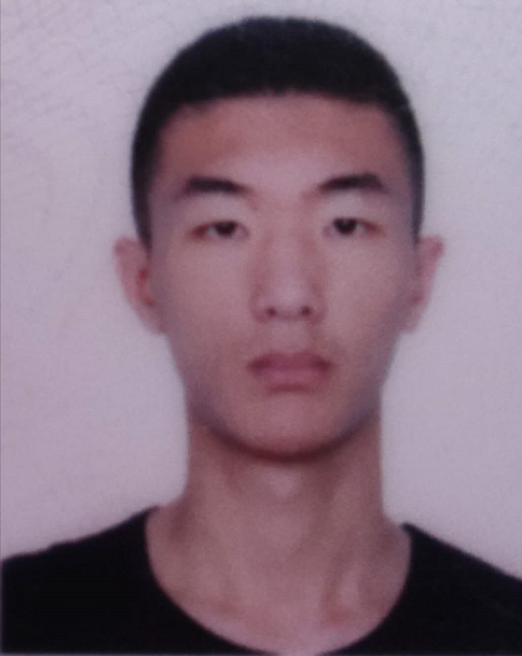
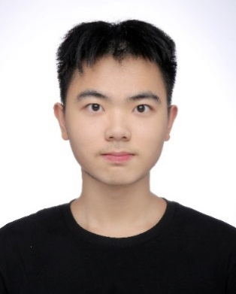
Introduction to team members - Technical Group
Dequn Teng
Jia Zhang
Juncheng Liu
Tianshuo Yang
Chengrui Zhang
Person in Charge
Product
UI
Backend
Model
Stanford AI and Algorithm Session Scholarship for Academic ExcellencE XJTLU ,5%; 7 patents for inventions.
Task：UI，use case diagram
Ability：Java, C++，Adobe Premiere, Photoshop, Design，Paint
Task：Website UI design
Ability：Java, C++, Python, Adobe Premiere, Photoshop, UI，coding，filming editing
Java, Python, php，linux，thinkphp，vue,
XJTLU blockchain application top 1，Humanity and technology award
Liangu Blockchain application and innovation award（4％）
java, C++, mysql, mongodb, linux, Rust, node.js,
2019 SURF Visual Track

Slide 3
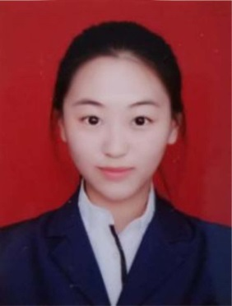
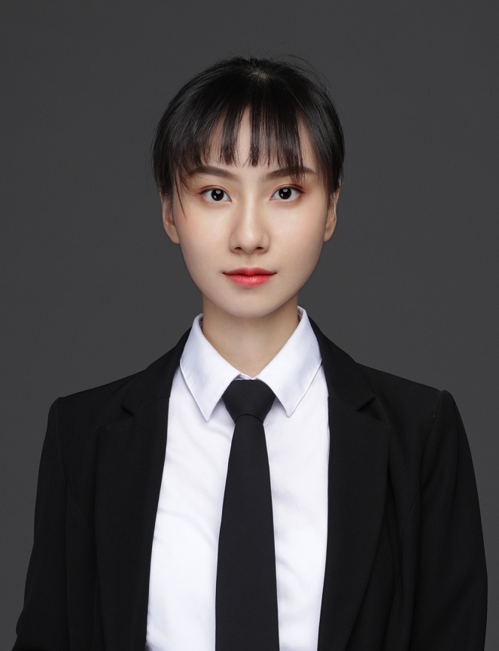
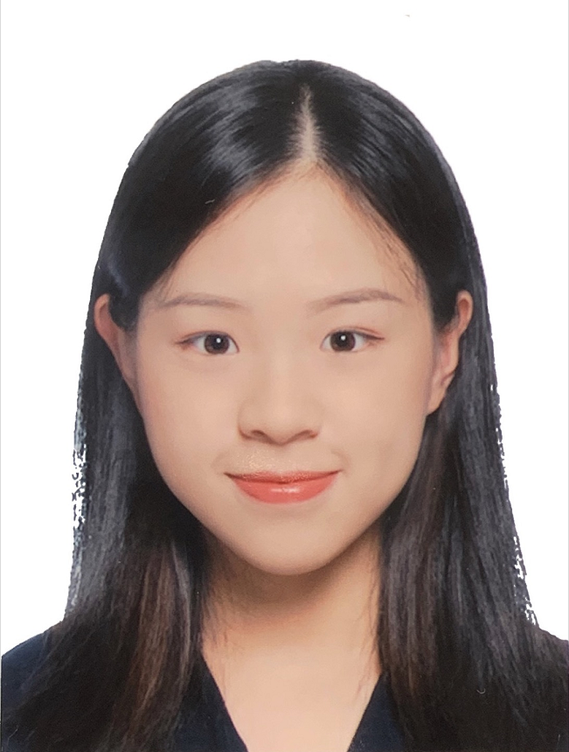
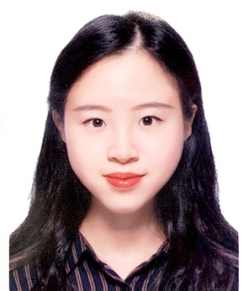
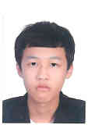
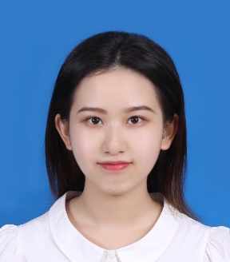
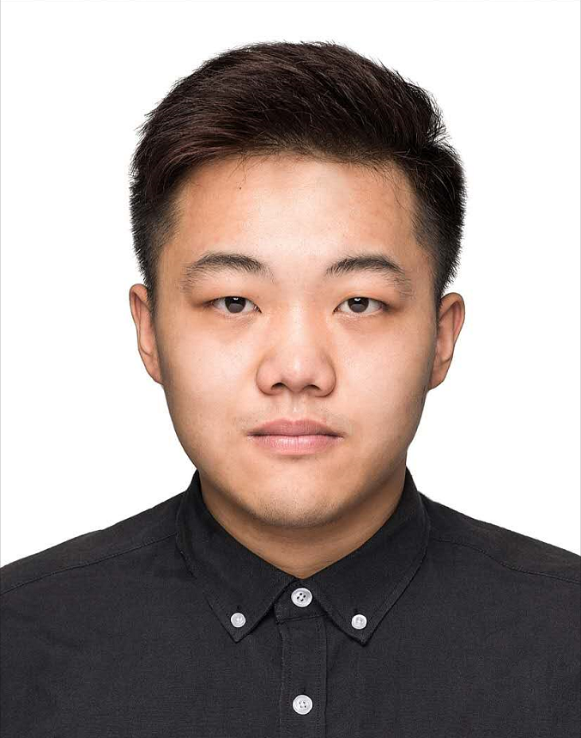
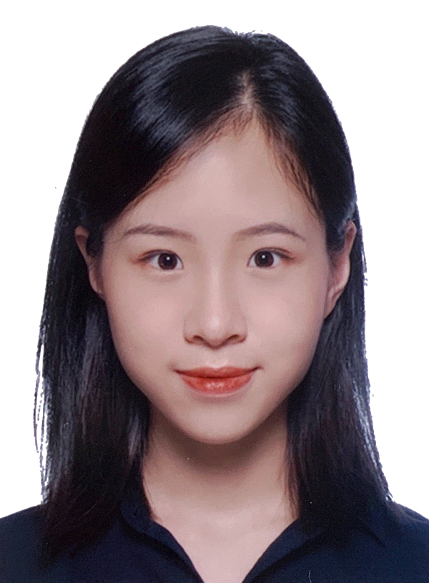
Introduction to team members - Business Group
Zhili Zhao
Yajing Liu
Huating Wu
Huayan Wu
Person in Charge
entrepreneurship
Market
Market
Continuing Start up；Company management experience of 30 people，capable with communication ability；
Innovation and competition Third prize
UCL Entrepreneurship
Sino-Us Creativity Competition Second prize；BM business group top 3；data analysis competition top 3
Proficient in Google Analytic, SQL, SPSS
Marketing P&G 2020 CEO challenge，Shanghai STP talents program；XJTLU academic excellence scholarship （1%)
Proficient in GA, Adobe Photoshop, SPSS；
C3 creativity challenge top 1，2019年Ｑ1 world cafe exchange table competition excellent prize
Zhaolu Zhang
Shengyi Ding
Yizhang Gong
Huazhan Wu
Accounting
Accounting
Accounting
Market
Columbia University Instructional Technology
XJTLU best performance in FYP
MCM M prize eco campus research evaluation contest International Sillian Valley Third Prize
ACCA 8； two SURF projects
ACCA5 subject ；XJTLU charity club first hand；XJTLU ；
Business Model Experience
ACCA过6门通过；PPT设计；Excel Sage； PWC you plus
Project
精通Adobe Photoshop、SPSS、市场研究、营销计划撰写、创业计划书撰Excellent Writing Experience

